Slide 1

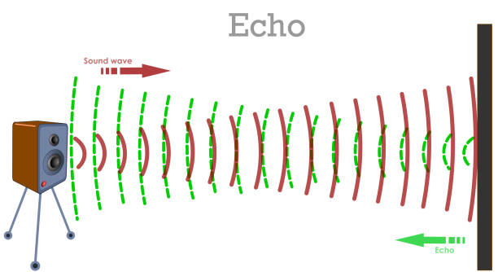
Biology for Engineers
21BE45 Echolocation

Slide 2
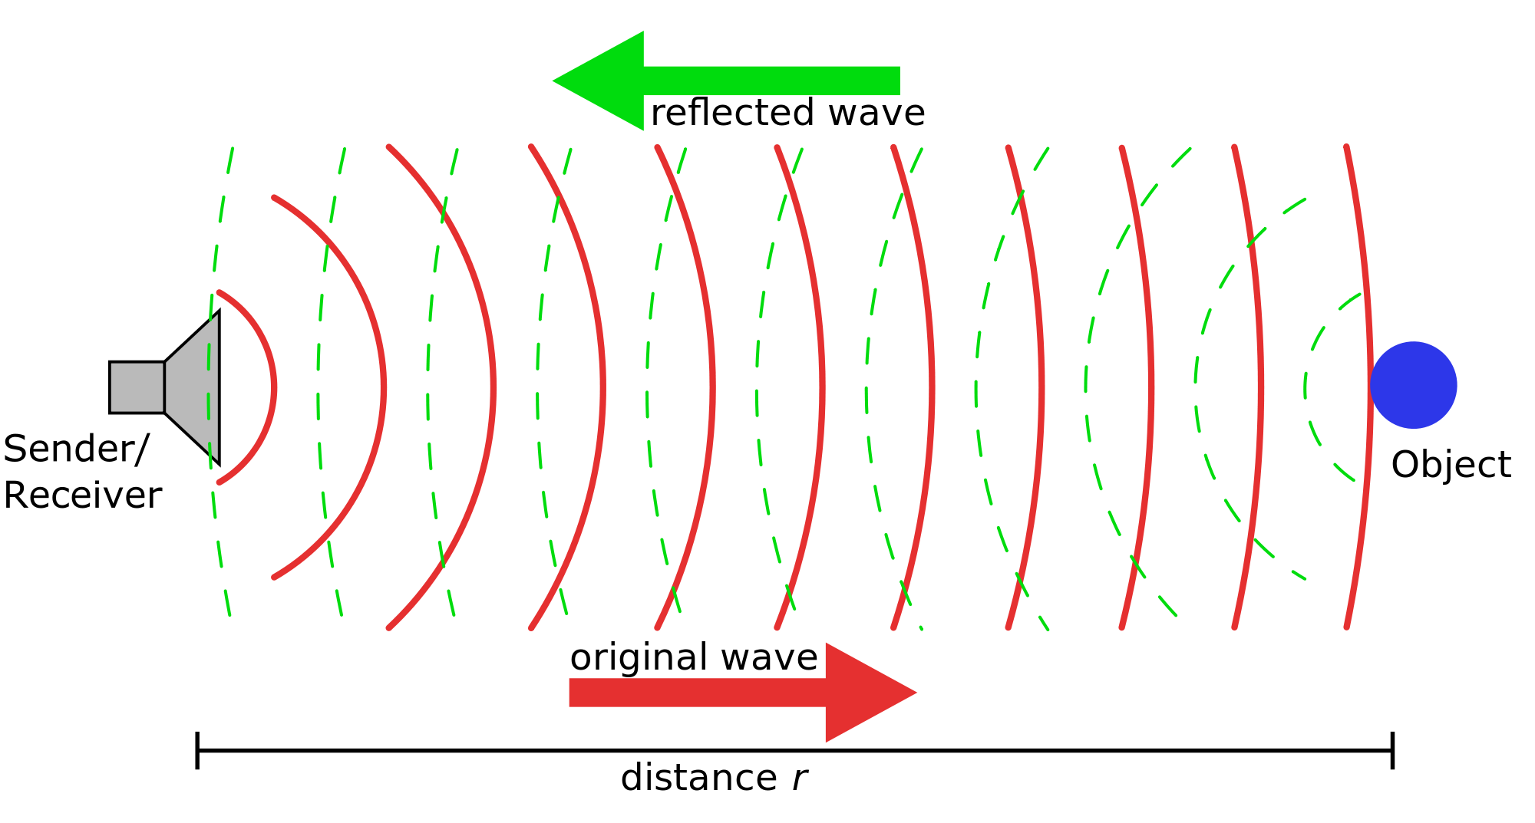
Biology for Engineers
Nature-bioinspired materials and mechanisms
Echolocation
What is Echolocation?
Echolocation is a physiological process for locating distant or invisible objects (such as prey) by means of sound waves reflected back to the emitter by the objects.
Echolocation is used for orientation, obstacle avoidance, food procurement, and social interactions.

Slide 3
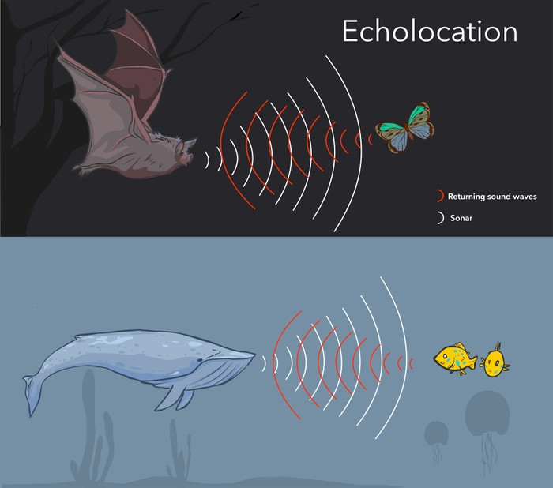
Biology for Engineers
Nature-bioinspired materials and mechanisms
Echolocation
Nature’s own sonar system, echolocation occurs when an animal emits a sound wave that bounces off an object, returning an echo that provides information about the object’s distance and size.
Over a thousand animal species can sense echolocate, including most bats, whales, and small mammals.
Many are nocturnal(active at night) burrowing, and ocean-dwelling animals that rely on echolocation to find food in an environment
Animals uses several methods for echolocation, from vibrating their throats to flapping their wings.

Slide 4
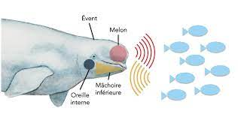
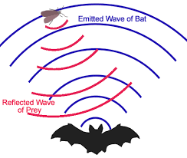
Biology for Engineers
Nature-bioinspired materials and mechanisms
Echolocation
For dolphins and toothed whales, this technique enables them to see in muddy waters or dark ocean depths, and may even have evolved so that they can chase squid and other deep-diving species.
Echolocation allows bats to fly at night as well as in dark caves. This is a skill they probably developed so they could locate night-flying insects that birds can’t find.

Slide 5
Biology for Engineers
Nature-bioinspired materials and mechanisms
Echolocation
How do dolphins use echolocation?
Dolphins and whales use echolocation by bouncing high-pitched clicking sounds off underwater objects.
The sounds are made by squeezing air through nasal passages near the blowhole.
These sound waves then pass into the forehead, where a fatty structure called the melon focuses them into a beam.
If the echolocating waves hits the object, the reflected sound is picked up through the animal’s lower jaw and passed to its ears.

Slide 6
Echolocating sounds are so loud that the ears of dolphins and whales are shielded to protect them.
Dolphins and whales use this method to work out an object’s distance, direction, speed, density and size.
Using echolocation, dolphins can detect an object the size of a golf ball, about the length of a football pitch away – much further than they can see.
By moving its head to aim the sound beam at different parts of a fish, a dolphin can also differentiate between species.

Slide 7
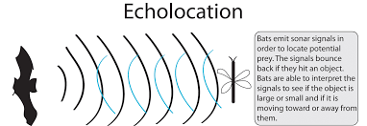
Biology for Engineers
Nature-bioinspired materials and mechanisms
Echolocation
How do bats use echolocation?
Bats make echolocating sounds in their larynxes and emit them through their mouths. Fortunately, most are too high-pitched for humans to hear – some bats can scream at up to 140 decibels, as loud as a jet engine 30m away.
Bats can detect an insect up to 5m away, work out its size and hardness, and can also avoid wires as fine as human hairs.
As a bat closes in for the kill, it cranks up its calls to pinpoint the prey.
To avoid being deafened by its own calls ( sound), a bat turns off its middle ear just before calling, restoring its hearing a second later to listen for echoes.

Slide 8
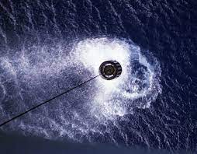
Biology for Engineers
Nature-bioinspired materials and mechanisms
Echolocation
Sonar
The full form of Sonar is Sound, Navigation and Ranging.
Sonar is a technique for detecting and determining the distance and direction of underwater objects by acoustic means.
Sound waves emitted by or reflected from the object are detected by sonar apparatus and analyzed for the information they contain.

Slide 9
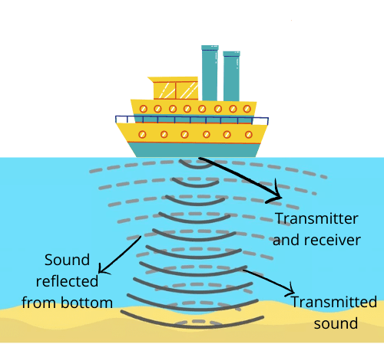
Biology for Engineers
Nature-bioinspired materials and mechanisms
Echolocation
Sonar
Sonar systems may be divided into three categories.
In active sonar systems an acoustic projector generates a sound wave that spreads outward and is reflected back by a target object. A receiver picks up and analyzes the reflected signal and may determine the range, bearing, and relative motion of the target.
Passive systems consist simply of receiving sensors that pick up the noise produced by the target (such as a ship, submarine, or torpedo). Waveforms thus detected may be analyzed for identifying characteristics as well as direction and distance.
The third category of sonar devices is acoustic communication systems, which require a projector and receiver at both ends of the acoustic path.

Slide 10
Biology for Engineers
Nature-bioinspired materials and mechanisms
Echolocation
Sonar
Sonar was first proposed as a means of detecting icebergs.
Interest in sonar was heightened by the threat posed by submarine warfare in World War I.
An early passive system, consisting of towed lines of microphones, was used to detect submarines
Subsequent developments included the echo sounder or depth detector, rapid-scanning sonar, and side-scan sonar
Sonar is also used in acoustic homing torpedoes, in acoustic mines, and in mine detection.
Nonmilitary uses of sonar include fish finding, depth sounding, mapping of the sea bottom, Doppler navigation, and acoustic locating for divers.

Slide 11
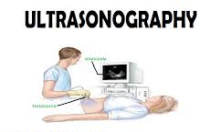
Echolocation
ULTRASONOGRAPHY
A procedure that uses high-energy sound waves to observe tissues and organs of the body.
Ultrasound frequencies range from 2 to approximately 15 MHz,
The sound waves make echoes that form pictures of the tissues and organs on a computer screen (sonogram).
Ultrasonography may be used to help diagnose diseases, such as cancer.
It may also be used during pregnancy to check the fetus (unborn baby) and during medical procedures, such as biopsies.
Also called ultrasound.

Slide 12
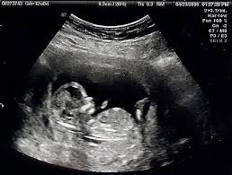
Biology for Engineers
Nature-bioinspired materials and mechanisms
Echolocation
Ultrasonography
Diagnostic ultrasound, also called sonography or diagnostic medical sonography, is an imaging method that uses sound waves to produce images of structures within your body.
The images can provide valuable information for diagnosing and directing treatment for a variety of diseases and conditions.
Most ultrasound examinations are done using an ultrasound device outside your body, though some involve placing a small device inside your body.

Slide 13
Biology for Engineers
Nature-bioinspired materials and mechanisms
Echolocation
Why Ultrasound is done?
Ultrasound is used for many reasons, including to:
View the uterus and ovaries during pregnancy and monitor the developing baby's health
Diagnose gallbladder disease
Evaluate blood flow
Guide a needle for biopsy or tumor treatment
Check the thyroid gland
Find prostate problems
Assess joint inflammation
Evaluate metabolic bone disease

Slide 14
Biology for Engineers
Nature-bioinspired materials and mechanisms
Echolocation
Risks and Limitations
Diagnostic ultrasound is a safe procedure that uses low-power sound waves.
There are no known risks.
Ultrasound is a valuable tool, but it has limitations.
Sound waves don't travel well through air or bone, so ultrasound isn't effective at imaging body parts that have gas in them or are hidden by bone, such as the lungs or head.
Ultrasound may also be unable to see objects that are located very deep in the human body. To view these areas, other imaging tests such as CT or MRI scans or X-rays can be performed.

Slide 15
Biology for Engineers
Nature-bioinspired materials and mechanisms
Echolocation
Procedure
Ultrasound imaging, or ultrasonography (US), uses high-frequency sound pulses that are emitted from a hand-held ultrasound transducer, or probe.
• The transducer is applied to the patient's skin via a coupling gel, and the sound pulses are reflected back to the transducer from structures within the patient.
• The magnitude of the reflected sound, or “echo,” is converted into a gray-scale image.
• Tissues that are highly reflective of the sound, or “echogenic,” such as bone, appear bright.
-Tissues that allow transmission of the sound pulses, or are poorly echogenic, such as fluid, appear dark or black.

Slide 16
Biology for Engineers
Nature-bioinspired materials and mechanisms
Echolocation
Sometimes, ultrasounds are done inside your body.
In this case, the transducer is attached to a probe that's inserted into a natural opening in your body.
Examples include:
Transesophageal echocardiogram: A transducer, inserted into the esophagus, obtains heart images. It's usually done while under sedation.
Transrectal ultrasound: This test creates images of the prostate by placing a special transducer into the rectum.

